Slide 1
Streamlining Ticket Assignment for Efficient Support Operations
A NAAN MUDHALVAN PROJECT
NM2025TMID13343

Slide 2
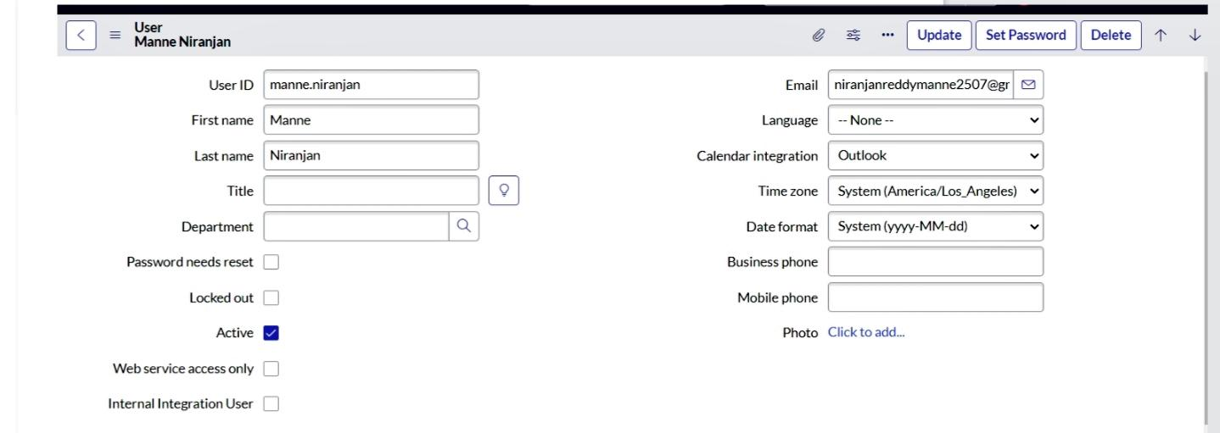
SERVICE NOW DEVELOPER TO SERVICE NOW PROJECT CENTER
Create user
Open service now. Click on All >> search for users Select Users under system security Click on new Fill the following details to create a new user
6.Click on submit

Slide 3
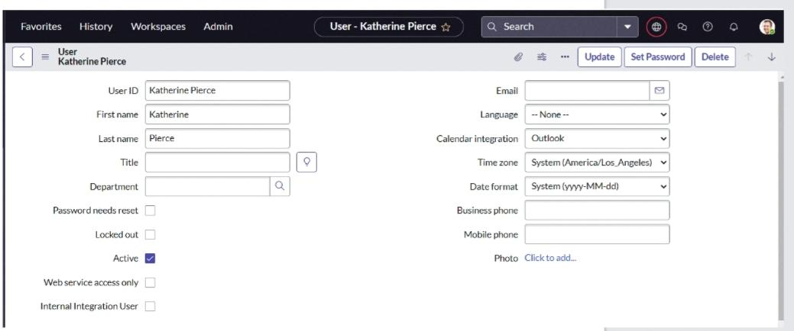
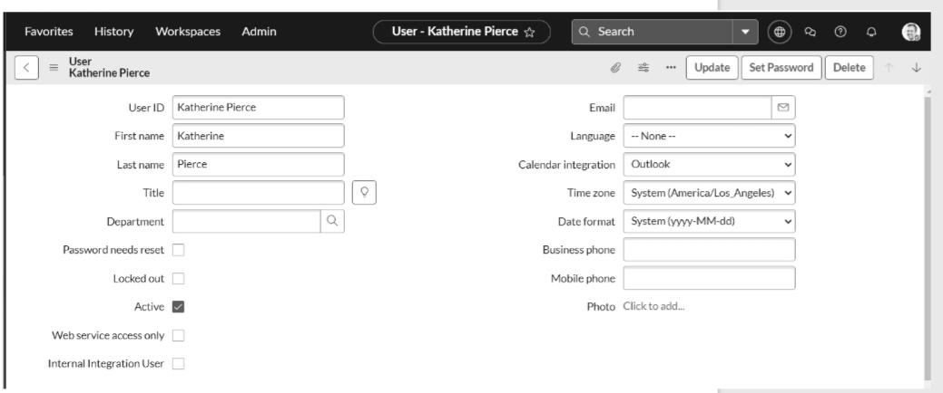
USER FOR KATHRINE PICTURE
Create one more user
Create another user with the
following details
2.Click on submit

Slide 4
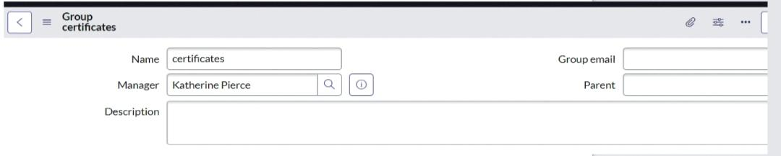
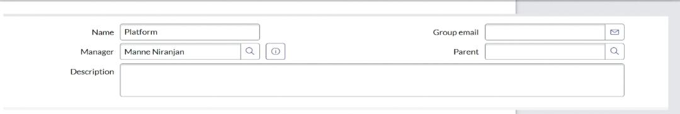
CREATE A GROUP
Open service now. Click on All >> search for groups Select groups under system security Click on new Fill the following details to create a new group
Create one more group: Create another group with the following details

Slide 5
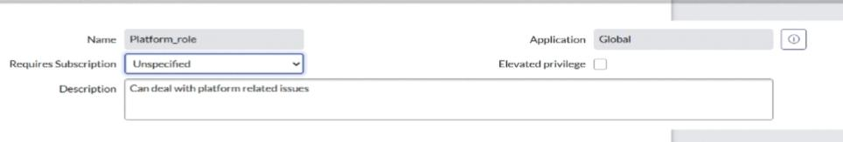
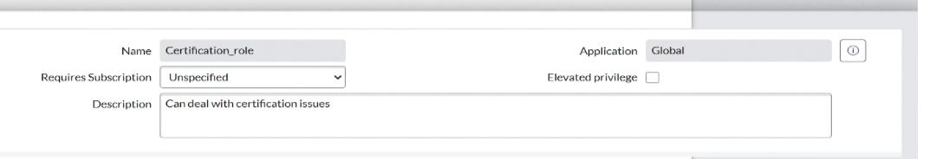
CREATE ROLES
Open service now. Click on All >> search for roles Select roles under system security Click on new Fill the following details to create a new role
Click on submit
Create one more role: Create another role with the following details

Slide 6
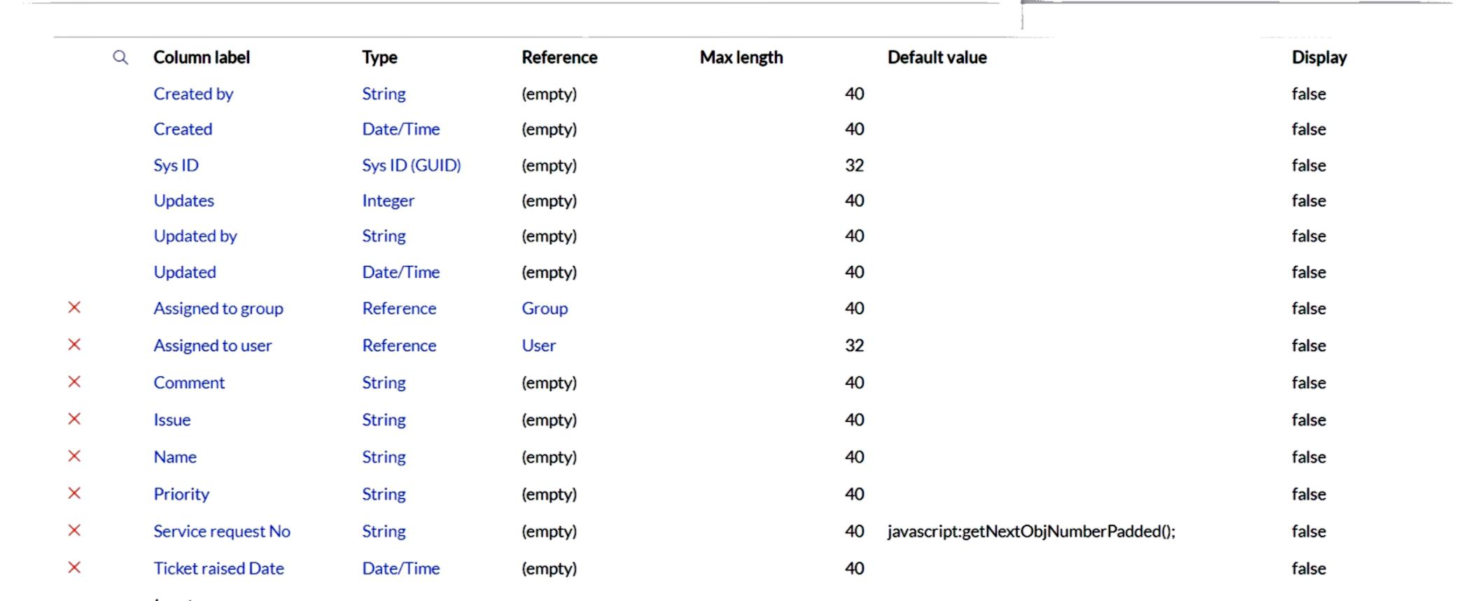
CREATE TABLE
Open service now. Click on All >> search for tables Select tables under system definition Click on new Fill the following details to create a new table Label : Operations related Check the boxes Create module & Create mobile module Under new menu name : Operations related Under table columns give the columns
Click on submit Create choices for the issue filed by using form design Choices are unable to login to platform 404 error regarding certificates regarding user expired

Slide 7
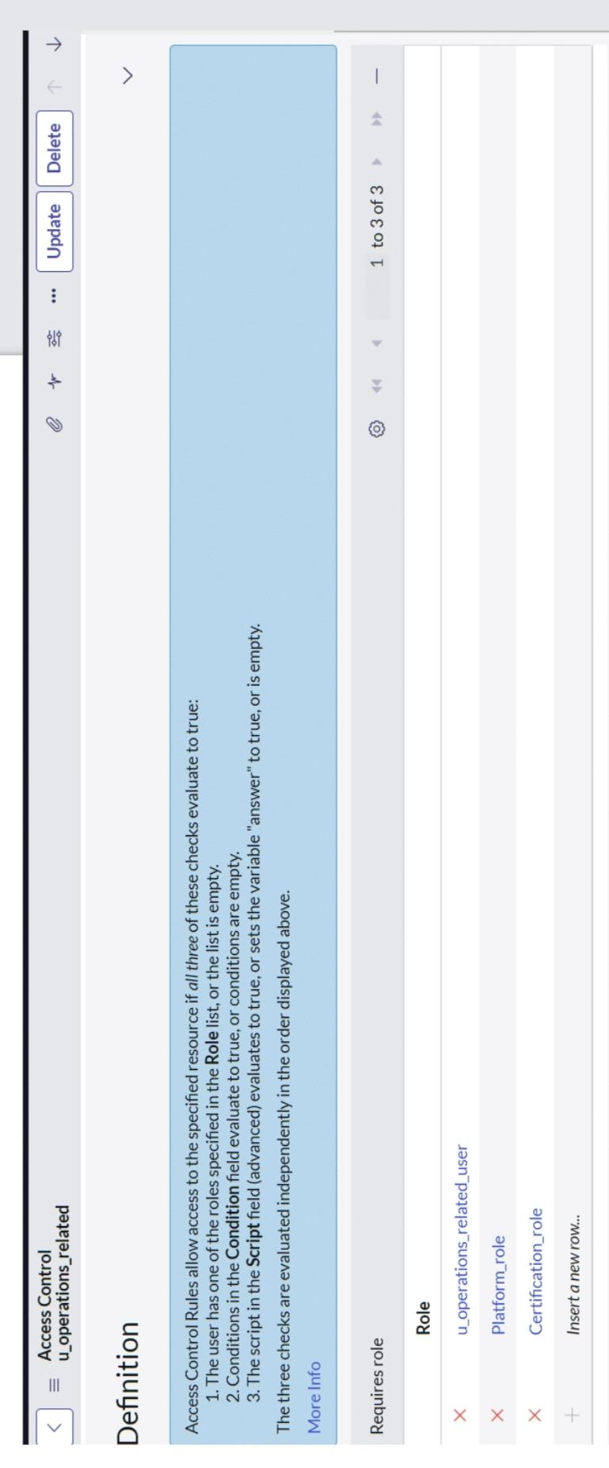
ASSIGN ROLE TO TABLE
Click on u_operations_related write operation Under Requires role Double click on insert a new row Give platform role And add certificate role
Open service now. Click on All >> search for tables Select operations related table Click on the Application Access Click on u_operations_related read operation Click on the profile on top right side Click on elevate role Click on security admin and click on update Under Requires role Double click on insert a new row Give platform role And add certificate role Click on update

Slide 8
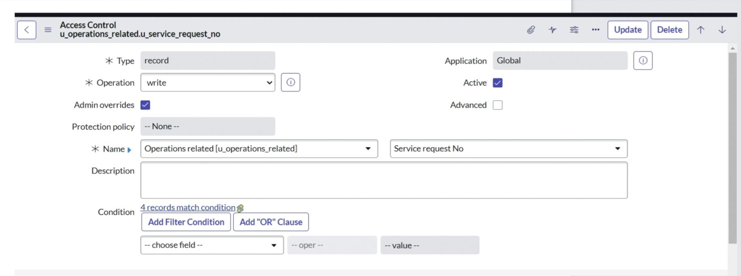
CREATE ACL
Open service now. Click on All >> search for ACL Select Access Control(ACL) under system security Click on new Fill the following details to create a new ACL

Slide 9
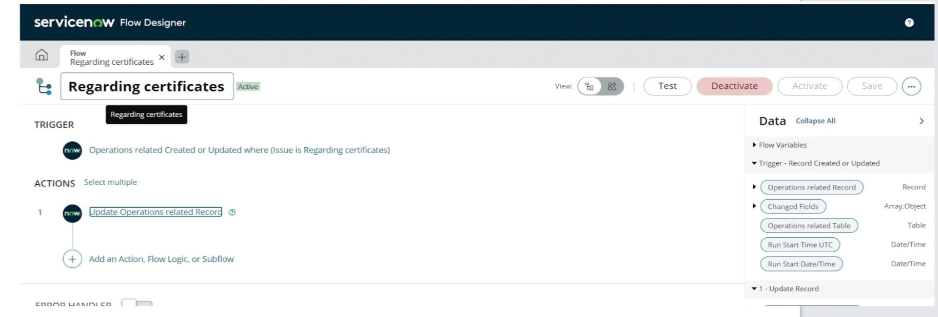
Create a Flow to Assign operations ticket to Platform group
Open service now. Click on All >> search for Flow Designer Click on Flow Designer under Process Automation. After opening Flow Designer Click on new and select Flow. Under Flow properties Give Flow Name as “ Regarding Platform ”. Application should be Global. Select Run user as “ System user ” from that choice. Click on Submit.
Give the field as “ Assigned to group ”. Give value as “ Platform ”. Click on Done. Click on Save to save the Flow. Click on Activate.
It’s completed

Slide 10

CONCLUSION
Streamlining Ticket Assignment for Efficient Support Operations
This project has done by
Pragadeeshwaran.M
Narayanasami.D
Hari Haran
K.omkumar
The implementation of the automated ticket routing system at ABC Corporation has been a significant success. By leveraging the capabilities of ServiceNow, we have streamlined the process of assigning support tickets to the appropriate teams, addressing the challenges of manual routing, and ensuring timely resolution of issues.

